Slide 1
Customer Segmentation Model Using Machine Learning
Problem Statement
To identity risk customers and providing targeted retention strategies.
Team Members:
Member 1 – Tushar Kant Anand
Member 2 – Hrithik Sharma
Member 3 – Hrithik Wuthoo
Member 4 – Iftisam Tariq

Slide 2
Scope
Product development:
By understanding the unique needs and preferences of each customer segment, business can develop and trailor therir product and services to meet their specific requirement of each segment, resulting in improved customer satisfaction and retention.
Sales forecasting:
By identifying price sensitive customer segments, business can develop pricing strategies that are more likely to appeal to each segment, resulting is increased sales
Pricing strategies: By identifying price sensitive customer segmentation , business can develop pricing strategies that are more likely to appeal to each segment, result in increased .

Slide 3
Tech Stack
Programming languages: Python, HTML,CSS,JavaScript
Data manipulation and analysis libraries/tools: Pandas, NumPy, Matplotlib and Seaborn, Flask
Database system : My SQL or Oracle
Integrated development environment (IDEs): Jupyter Notebook, VS Code

Slide 4
Customer Segmentation Model
Project Features/Highlights:
Demographic Segmentation
Firmographic Segmentation
Geographic Segmentation
Value Segmentation
Technographic Segmentation
Behavioural Segmentation
Psychographic Segmentation.

Slide 5
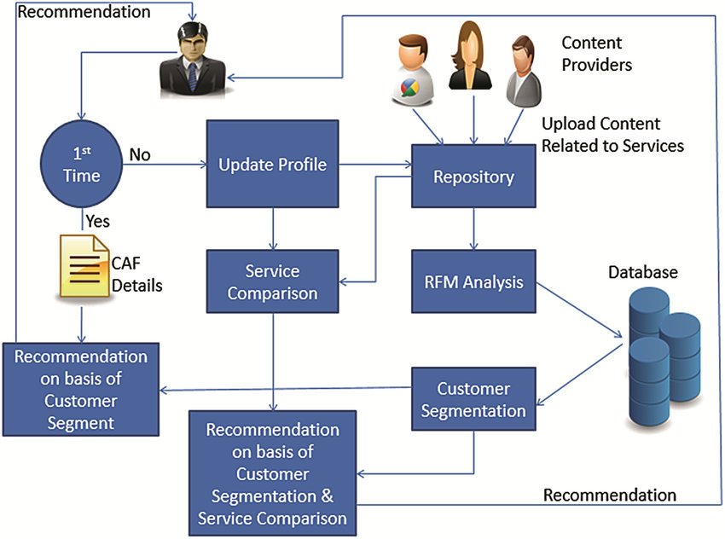
Work flow
Data collection | Data preprocessing | Data Analysis
Visualising the clusters | K means clustering | Optimum No of Clusters

Slide 6
References:-
https://www.javatpoint.com/customer-segmentation-using-machine-learning
https://www.researchgate.net/publication/360032683_CUSTOMER_SEGMENTATION_TECHNIQUES
https://www.kaggle.com/code/fabiendaniel/customer-segmentation

